Slide 1

Worldwide-ADNI Update Meeting
Friday, July 14, 2017
London, England
EUROPEAN ADNI
(PharmaCog, EPAD, AMYPAD, SRA-NED)
Jorge Jovicich
Giovanni B Frisoni
Center for Mind/Brain Sciences
University of Trento
Trento, Italy
Lab Alzheimer’s Neuroimaging & Epidemiology, IRCCS Fatebenefratelli, Brescia, Italy
Memory Clinic and LANVIE Laboratory of Neuroimaging of Aging, University Hospitals and University of Geneva, Geneva, Switzerland

Slide 2
EUROPEAN ADNI: diachronic vision
RESEARCH
CLINIC
Use of biomarkers for diagnosis and treatment
GAAIN
N=340 000
EMIF
N= 1 221
AMYPAD Px
Pilot
E-ADNI
PharmaCog
E-ADNI
N=4 500
EPAD
N=6 000
AMYPAD Dx
N=59
N=150
N=900
Harmonisa tion
Harmonisa tion
Harmonisa tion
Policy view
Policy view
Npsy
3d MRI
CSF
Diff. MRI
Rest fMRI
FBB PET
FMM PET
SRA-NeD
Geneva Roadmap
Notes:
Please use animations, they are supposed to follow the logic.
The e-adni direct thread is made of the solid arrows, direct meaning that methods and patients of eralier efforts have fed later ones. The dotted arrows denote data sharing.
Harmonisation efforts have been mandatory at the outstart to develoip multicentre data collection. The more recent effort is translation in the clinic of biomarker findings. Here, a strategic and global vision is needed (srea-ned and roadmap) and is already being implemented (the roadmap has fed the design of amypad dx).

Slide 3

E-ADNI (PHARMACOG WP5)
Journal of Alzheimer’s Disease, WORK IN PROGRESS
 | Variables of Interest | Preliminary Titles | 1st author *equally contributing authors | Last author
1 | Structural markers (3T MRI: T1, DTI, FLAIR) | Predicting and monitoring short term disease progression in aMCI patients with prodromal AD: structural brain biomarkers | Marizzoni M | Frisoni GB
2 | Functional markers (3T MRI: rsfMRI; EEG: rsEEG, auditory oddball ERP) | Predicting and monitoring short term disease progression in aMCI patients with prodromal AD: functional brain biomarkers | Jovicich J*, Babiloni C* | Frisoni GB
3 | Peripheral markers (blood biomarkers: Abeta and innate immunity-related molecules) | Predicting and monitoring short term disease progression in aMCI patients with prodromal AD: blood biomarkers | Albani D | Frisoni GB
4 | CSF, 3T MRI, EEG/ERP, peripheral biomarkers | Biomarker matrices to diagnose and track short term disease progression in aMCI patients with prodromal AD | Marizzoni M | Frisoni GB

Slide 4
European Prevention of
Alzheimer’s Dementia
Aim: to create a platform for faster and better assessment of drugs for the prevention of Alzheimer’s disease (AD), in people with very early or no symptoms at all
3 Major components of EPAD
Cohorts/Registry (PCs)
Longitudinal
Cohort Study
Proof of Concept (PoC) Study
EPAD
Registry
N=24,000
EPAD
LCS
N=6,000
EPAD
PoC
N=1,500
Adaptative
trial
Active cohorts with non-demented participants >50 years
Willingness to have participants enrolled in EPAD LCS and PoC
Notes:
Here you may wish to mention that jose luis molinuevo may touch on epad in his talk, right after yourself

Slide 5
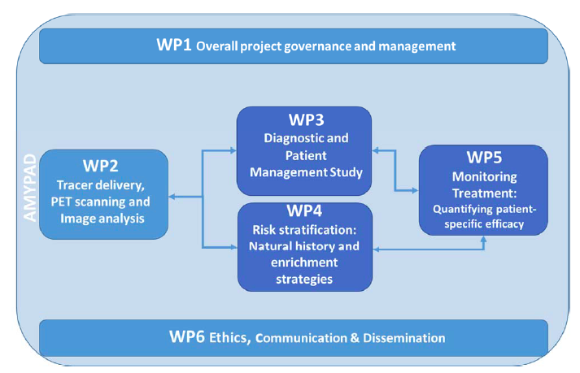
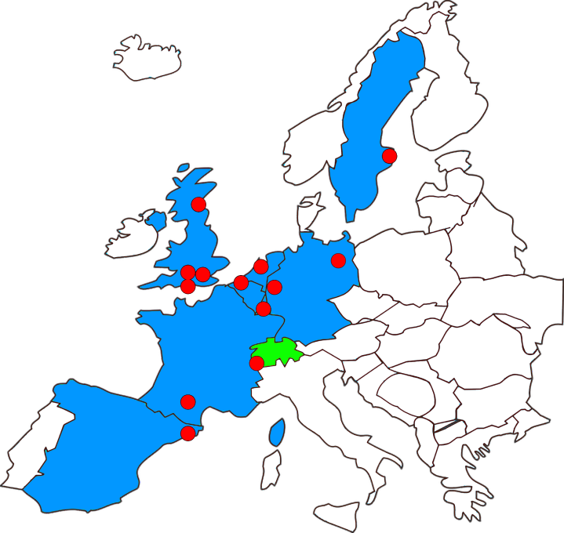
Amyloid PET in EPAD
Determine clinical utility of Amyloid PET
Diagnostic value – patient management
Risk stratification – EPAD long cohort (LCS)
Monitoring treatment – clinical trials
AMYPAD Consortium
8 academic centers, 3 pharma companies, 2 SMEs and 1 patient organization across Europe

Slide 6
AMYPAD: Primary endpoint
Primary Endpoint: Difference in the proportion of patients with an etiologic diagnosis with ≥90% confidence.

Slide 7
Secondary endpoints
Diagnosis and Confidence | Patient Management | Health Economic Outcomes | Imaging Assessment
Time to communicate etiological Dx | N. of patients randomized to AD clinical trials | Impact of patient reported outcomes | Estimate amyloid deposition over 18 months
Changes in etiological Dx over time | Change in Management Plan | Cost of diagnostic WU to high conf. Dx | Stand. methods of image quantitation
Changes of likelihood that ss are due to AD |  | Differences of use of medical resources
Changes over time in utilization of amyloid PET imaging in Free Choice Arm |  | N. of subject discharged by memory clinic after exclusion of AD
Notes:
You do not wish to mention all outcomes, juist the 4 major fields.

Slide 8
Geneva Roadmap to Clinical Validity and Utility of AD biomarkers

Slide 9
Geneva Roadmap to Clinical Validity and Utility of AD biomarkers

Slide 10





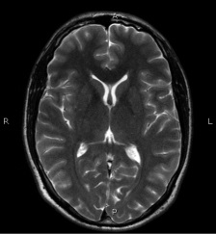
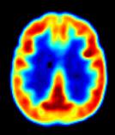
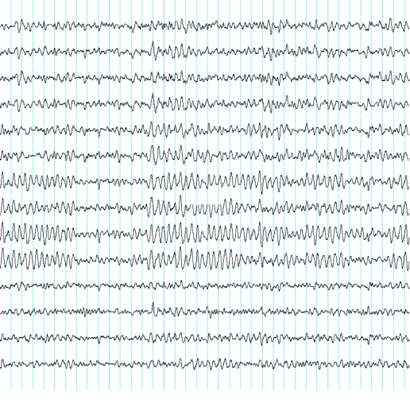

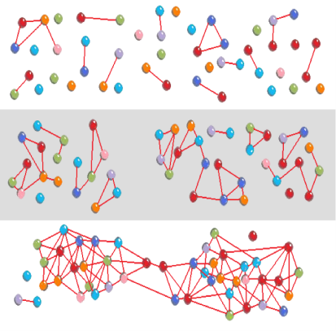
EU Joint Program - Neurodegenerative Disease Research
WORKING GROUPS ON HARMONISATION AND
ALIGNMENT IN BRAIN IMAGING METHODS
Our survey
Reached: research/clinical/industry neuroimaging communities
Determined: harmonization barriers & solutions for multicentric MRI/PET-SPECT/EEG
We propose a actions to exploit the potential of the MRI/PET/EEG biomarkers in large multicentric ND studies
General high-level actions
Methodological-specific actions
Developing Topic Poster #19691 (Wed July 19)

Slide 11


JPND Brain Imaging Working Groups meet Journal Editors
When: Monday July 17, 12.30-13.30
Where: IBIS STYLE LONDON EXCEL,
272 Victoria Dock Road Custom House,
London E16 3BY (room HMS Belfast).

Slide 12
Methodological barriers PET-SPECT
Multicenter neuroimaging harmonization barriers | Actions / Infrastructures to address barriers | Expected outcomes
Lack of harmonization for analyses tools and quantification (FDG-PET, amyloid PET, tau PET and dopaminergic PET/SPECT). Lack of standardization across amyloid PET tracers Lack of public normative reference data Lack of PET-SPECT comparisons (dopaminergic tracers) | ACTIONS/INFRASTRUCTURE 6 Create funded initiatives that support the following actions: Harmonize multi-vendor image reconstruction parameters and quantification Develop public databases of normal and ND patients (uniform with respect to acquisition and quantification) Create centralized analysis platforms for widely available markers lacking standardization of analysis such as FDG and dopaminergic markers. | Contribute towards more sensitive longitudinal multi-vendor neuroimaging ND studies Promote the use of the open-access platform by using it to share relevant information (ACTION 1) Contribute towards standardization of multicentric registry planning creation (ACTION 2) Contribute towards and promote the integration with past harmonization efforts (ACTION 3) Contribute to education (ACTION 4)
Developing Topic Poster #19691 (Wed July 19)
Notes:
You know these better than i do…

Slide 13
Methodological barriers MRI
Multicenter neuroimaging harmonization barriers | Actions / Infrastructures to address barriers | Expected outcomes
Lack of multi-vendor longitudinal harmonized MRI protocols compatible with state-of-the-art MRI equipment using recent hardware and software developments Many retrospective datasets exist that may be possible to use following appropriate harmonization. | ACTIONS/INFRASTRUCTURE 5 Create funded initiatives that support the following actions: Harmonize multi-vendor state-of-the art MRI acquisition and analyses protocols, in particular: High spatial resolution anatomical imaging, including quantitative tissue mapping (e.g., susceptibility, tissue relaxation, myelin, etc.) Microstructure and connectivity from dMRI High-temporal resolution rsfMRI and pMRI Quantify multi-vendor test-retest reproducibility establishing standardized and reference quality assurance metrics for different target markers. Evaluate best biomarkers for different NDs and experimental designs (cross-sectional, longitudinal) in the context of specific MRI acquisition and analyses protocols. Develop and validate efficient methods to harmonize retrospective MRI data. | Contribute towards more sensitive neuroimaging studies by updating harmonized protocol recommendations consistent with MR technology that is becoming widely available Promote the use of the open-access platform by using it to share relevant information (ACTION 1) Contribute towards standardization of multicentric registry planning creation (ACTION 2) Contribute towards and promote the integration with past harmonization efforts (ACTION 3) Contribute to education (ACTION 4)
Developing Topic Poster #19691

Slide 14
Methodological barriers EEG
Multicenter neuroimaging harmonization barriers | Actions / Infrastructures to address barriers | Expected outcomes
Lack of standardization of spectral source EEG analysis and high-resolution recordings Lack of quality assurance standardization (ocular motion and cardiac artifacts). Lack of clarity of the limits and opportunities of EEG biomarkers for NDs | ACTIONS/INFRASTRUCTURE 7 Create funded initiatives that support the following actions: Harmonize multi-vendor state-of-the-art acquisition and quality assurance protocols Harmonize biomarker extraction using spectral or time-domain analysis: Resting state (eyes open/closed) Event related (oddball, etc.) Quantify test/retest reliability from multi-vendor EEG data Evaluate best biomarkers for different NDs and experimental designs (cross-sectional, longitudinal) | Contribute towards more sensitive longitudinal multi-vendor neuroimaging ND studies Promote the use of the open-access platform by using it to share relevant information (ACTION 1) Contribute towards standardization of multicentric registry planning creation (ACTION 2) Contribute towards and promote the integration with past harmonization efforts (ACTION 3) Contribute to education (ACTION 4)
Developing Topic Poster #19691 (Wed July 19)

